Slide 1
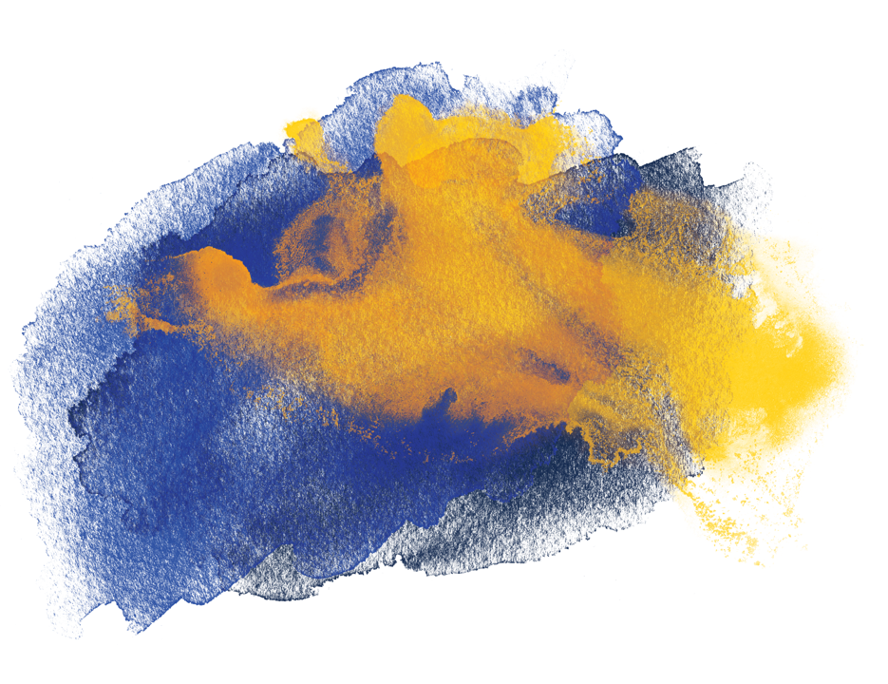
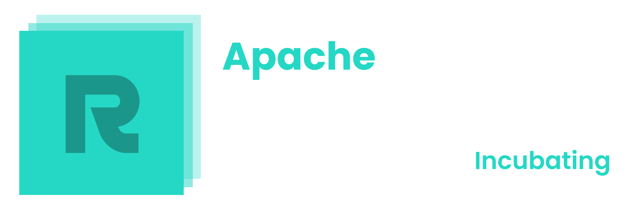

ResCanvas
- A Decentralized, Collaborative Drawing Platform
Henry Chou, Varun Ringnekar,
Chris Ruan, Shaokang Xie, Yubo Bai

Slide 2
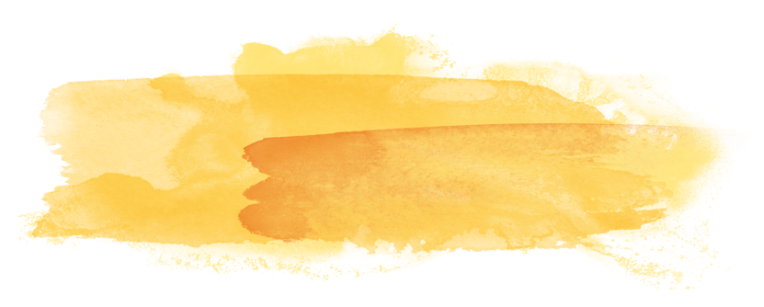
Current Challenge
Online drawing tools (e.g., Google Drawing, Canva) rely on centralized storage
Centralized data is vulnerable to:
Tracking and data sharing with third parties and advertisers
Potential censorship by private or public entities
Need for a privacy-preserving, censorship-resistant platform

Slide 3
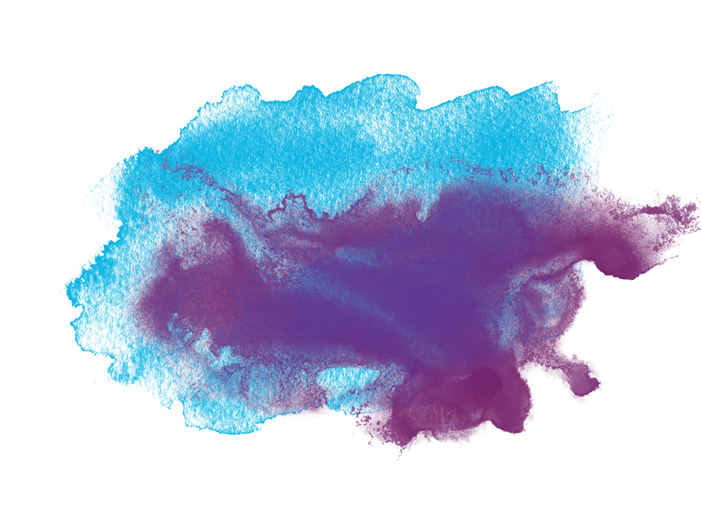
Motivation & Context
Drawing is a key form of expression and idea generation
Collaboration is essential but should not sacrifice privacy or freedom
Reddit’s pixel platform shows potential, but still centralized and limited in user interaction

Slide 4
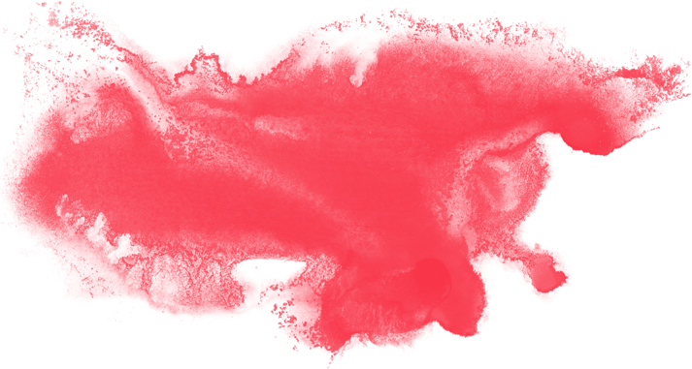
Introducing ResCanvas
A web-based drawing platform integrated with ResilientDB
Decentralized data storage:
Ensures no single authority can censor or exploit user data
Real-time, multi-user collaboration with minimal latency

Slide 5
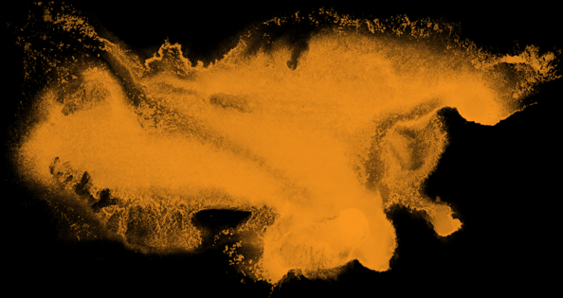
Key Technical Approach
ResilientDB:
A secure, decentralized database system
Stores drawings persistently, stroke by stroke
Redis Frontend Cache:
In-memory cache to speed up data retrieval
Minimizes latency, ensuring smooth collaborative drawing experiences

Slide 6
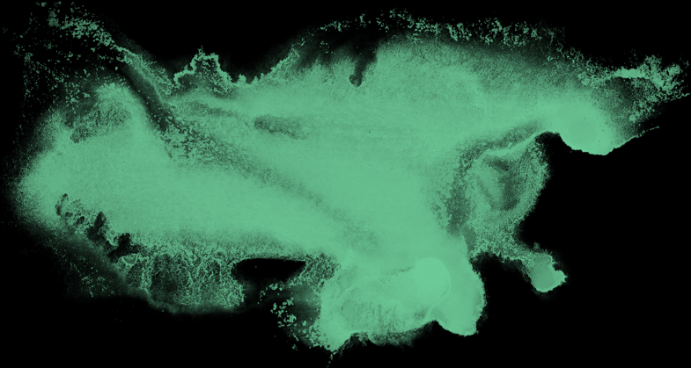
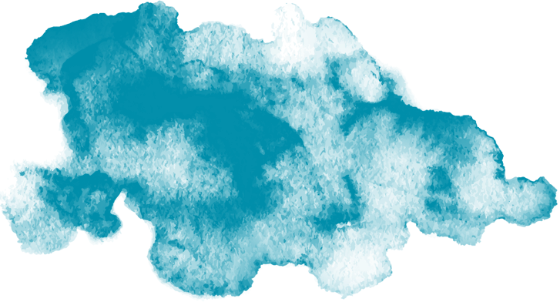
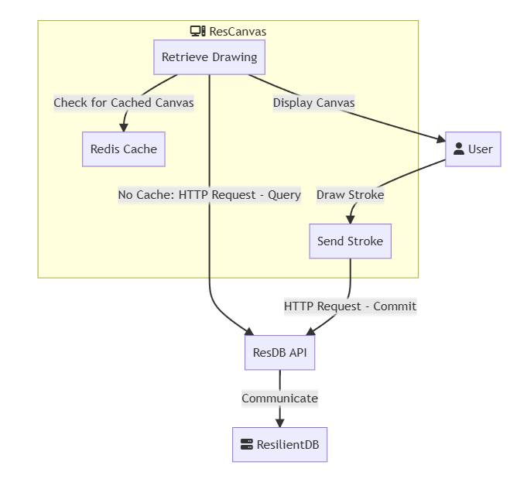
Architecture

Slide 7
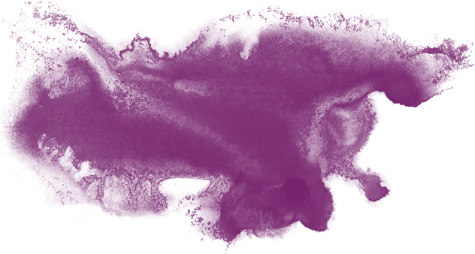
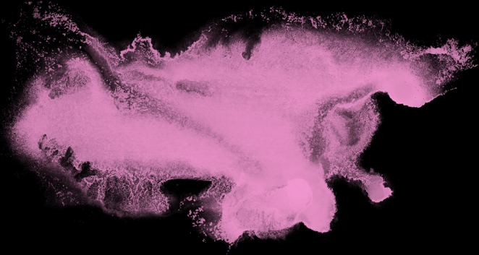

Core Features
Concurrent editing: Multiple users can draw simultaneously
Full stroke-by-stroke synchronization ensures consistent views for all participants
User customization: Color and thickness tools
Efficient data loading through Redis, enabling near-instant UI updates
Censorship-resistant, no third-party data sharing

Slide 8
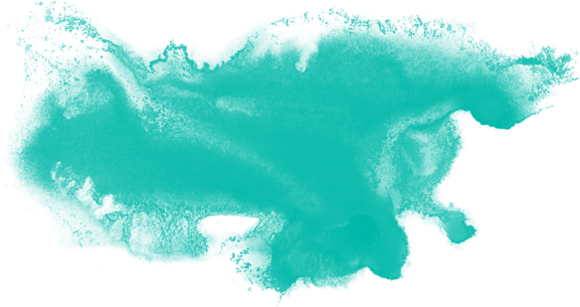
Privacy & Decentralization Benefits
No reliance on centralized servers that track user behavior
No selling of user data to advertisers
Drawings remain visible and modifiable without fear of external removal or interference
Users control their own data and collaborative environment

Slide 9
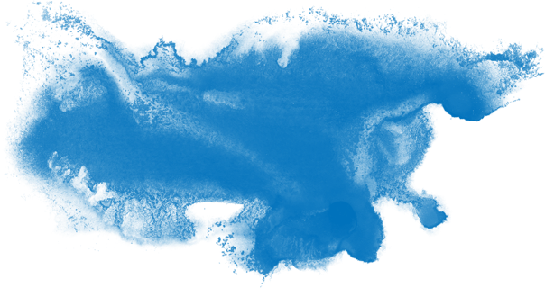
Future Enhancements
Operational Transformation:
Real-time editing adaptation similar to Google Docs
Smoother handling of concurrent changes without manual refreshes
Undo/Redo Functionality:
Complex version tracking of strokes across multiple users
Handling edge cases when one user’s changes build on another’s edits

Slide 10

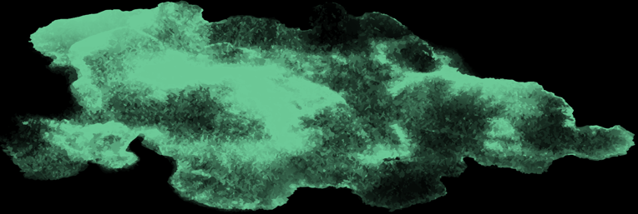
Potential Impact
Empower artists, designers, and creative communities to collaborate freely
Serve as a foundation for privacy-focused, decentralized applications
Encourage open ecosystems where end-users retain control over their data

Slide 11
Thank you!
Link to the ResCanvas

